Slide 1


Slide 2

STARTER – DAY 4

Slide 3
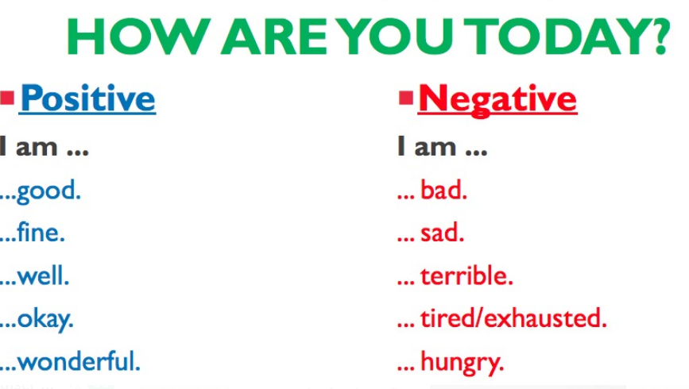
Hello!

Slide 4
Let’s remember the alphabet!

Slide 5
Personal Information - LINK
WHAT’S YOUR FIRST NAME?
WHAT’S YOUR LAST NAME?
HOW OLD ARE YOU?
WHERE ARE YOU FROM?
WHAT’S YOUR NATIONALITY?
WHAT’S YOUR PHONE NUMBER?
WHAT’S YOUR EMAIL ADDRESS?
WHAT’S YOUR JOB?
I’M FROM NATAL, IN BRAZIL.
IT’S 999 505 675.
IT’S GABRYELLE.
I’M BRAZILIAN.
IT’S GABYLOUYSE@GMAIL.COM
IT’S SILVA.
I’M 31 YEARS OLD.
I’M A TEACHER.

Slide 6
WHERE ARE YOU FROM?

Slide 7


